Slide 1
CIS 5525: Neural Computation
Topic V: Distributed Learning of Relations
Instructor: Kai Zhang
CIS @ Temple University, Spring 2020

Slide 2
Word Semantics
First thought: what do words mean?
The idea that is represented by a word, phrase, etc.
The idea that a person wants to express by using words, signs, etc.

Slide 3
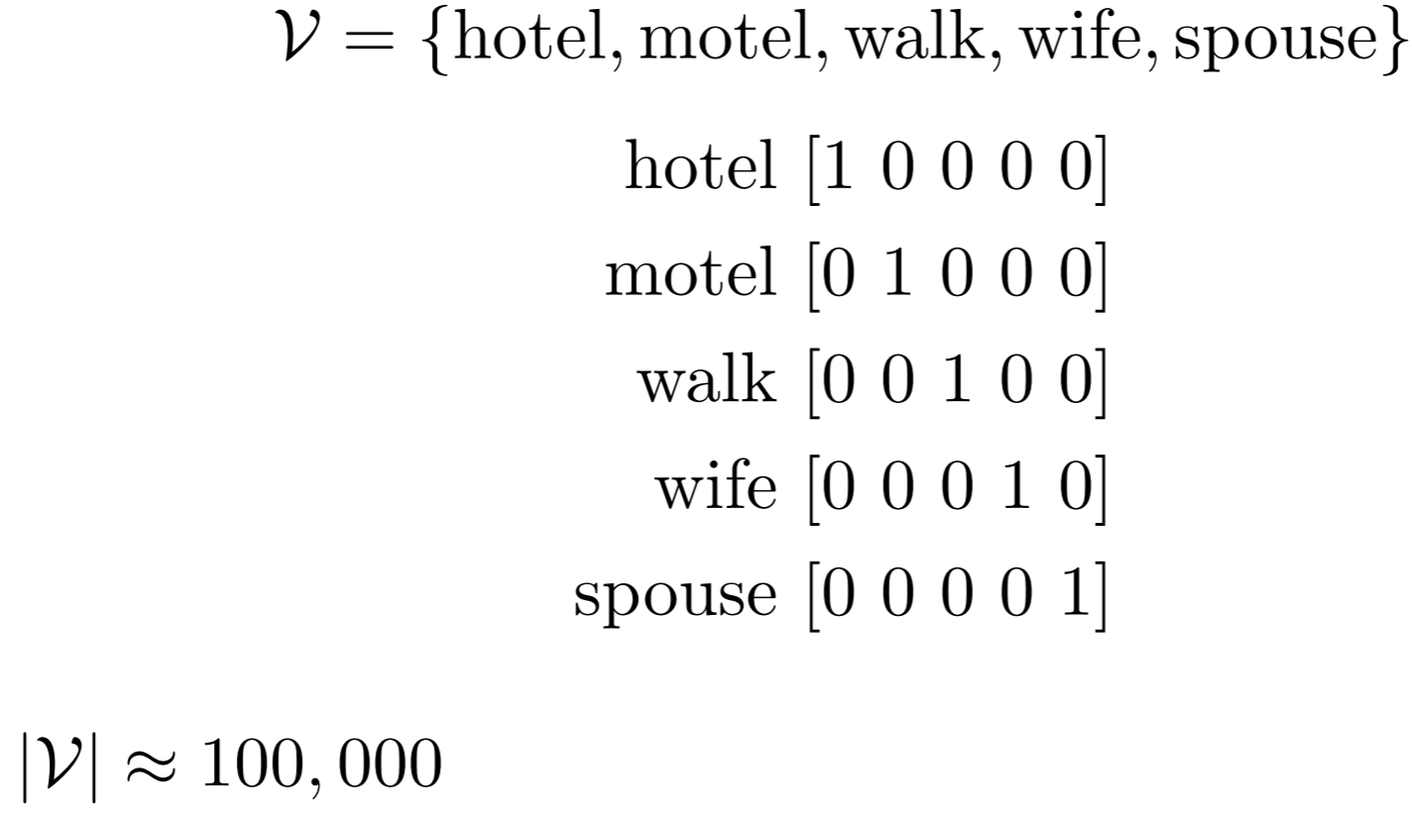
Represent Words in Computers
Discrete Representation: Words are atomic symbols (one-hot representation)

Slide 4
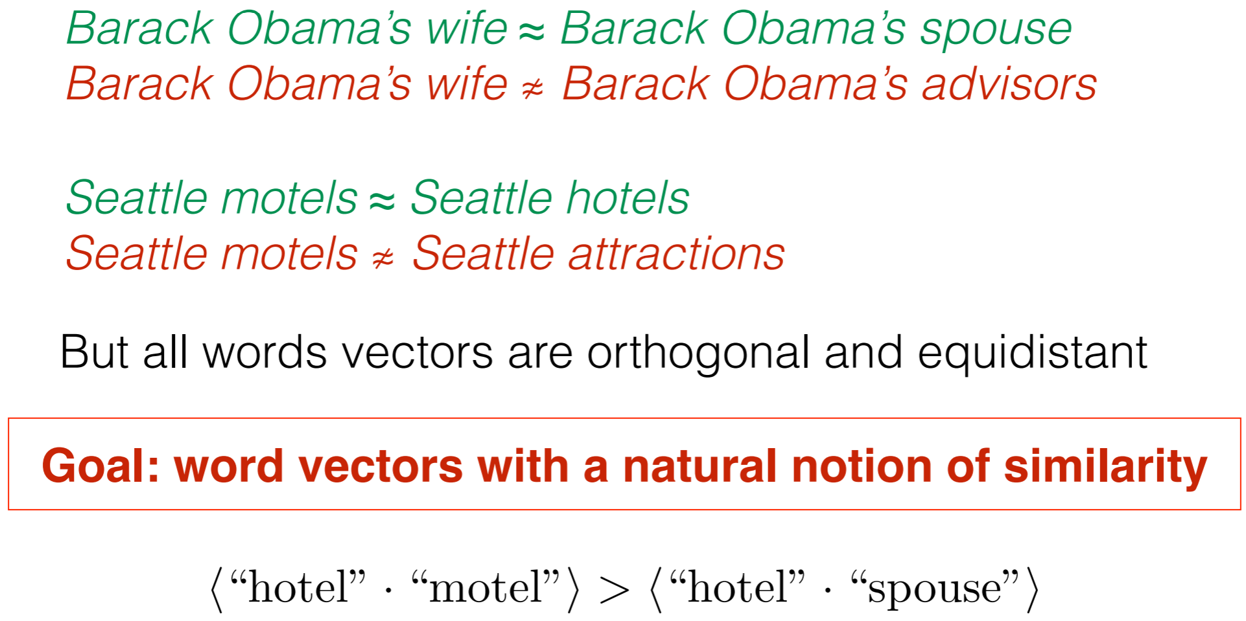
Drawback

Slide 5
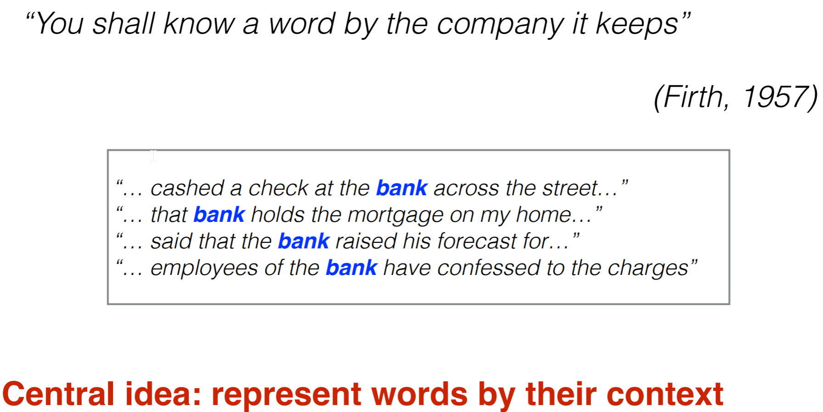
Distributional Similarity

Slide 6
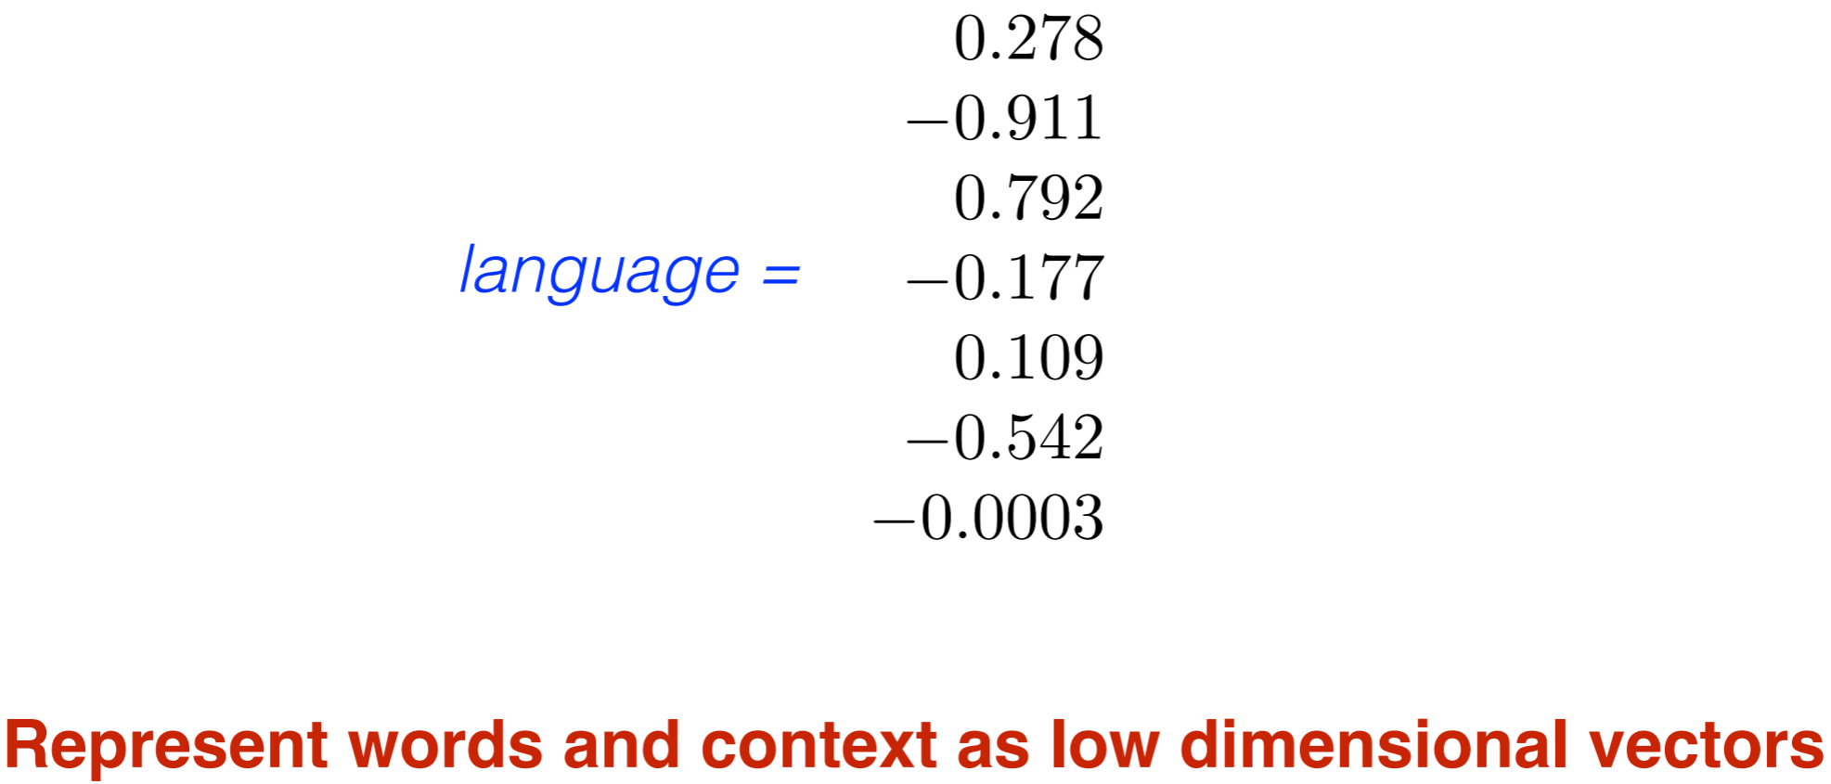
Distributed Representation

Slide 7
Distributed Representation
Why short and dense vectors?
Short vectors may be easier to use as features in machine learning (fewer weights to tune)
They may do better at capturing synonymy:
car and automobile are synonyms; but are distinct dimensions
a word with car as a neighbor and a word with automobile as a neighbor should be similar, but aren't

Slide 8
Dense Embeddings to Download
Word2vec
https://code.google.com/archive/p/word2vec/
Fasttext
http://www.fasttext.cc/
Glove
http://nlp.stanford.edu/projects/glove/

Slide 9
Word2vec
Idea
Instead of counting how often each word w occurs near "apricot“
Train a classifier on a binary prediction task:
Is w likely to show up near "apricot"?
we'll take the learned classifier weights as the word embeddings

Slide 10
Insight
Running(sequential) text provides implicitly supervised training data!
A word s near apricot
Acts as gold ‘correct answer’ to the question
“Is word w likely to show up near apricot?”
No need for hand-labeled supervision
The idea comes from neural language modeling
Bengio et al. (2003)
Collobert et al. (2011)

Slide 11
Word2Vec: SkipGram
Skip-gram algorithm
Treat the target word and a neighboring context word as positive examples.
Randomly sample other words in the lexicon to get negative samples
Use logistic regression to train a classifier to distinguish those two cases
Use the weights as the embeddings

Slide 12
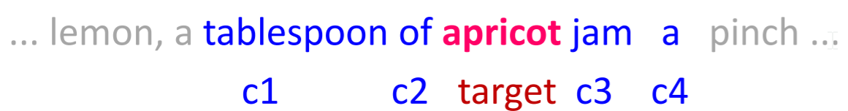
Training sentence
center word, denoted by v
Neighbor/outside word: those within in +/- 2 window, denoted by u
Maximum likelihood
P(outside|center): Probability that outside/context words appear given the center word
Center
word
Outside (context) word

Slide 13
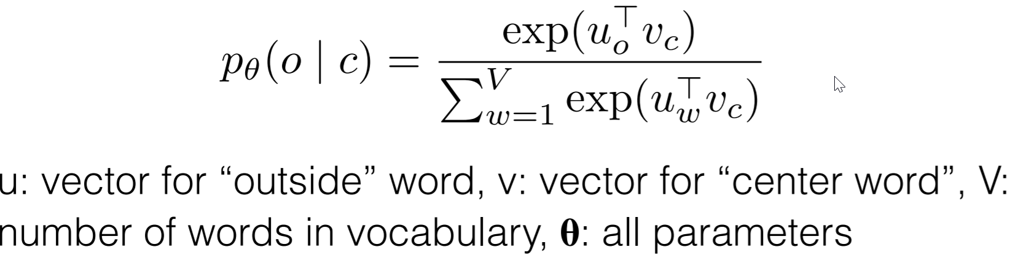
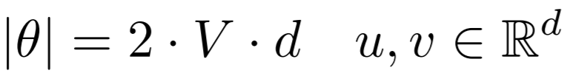
How to measure the probability p(outside|center)
Inner product between two word (vector): similarity
Need to normalize to probabilities
How many parameters involved

Slide 14
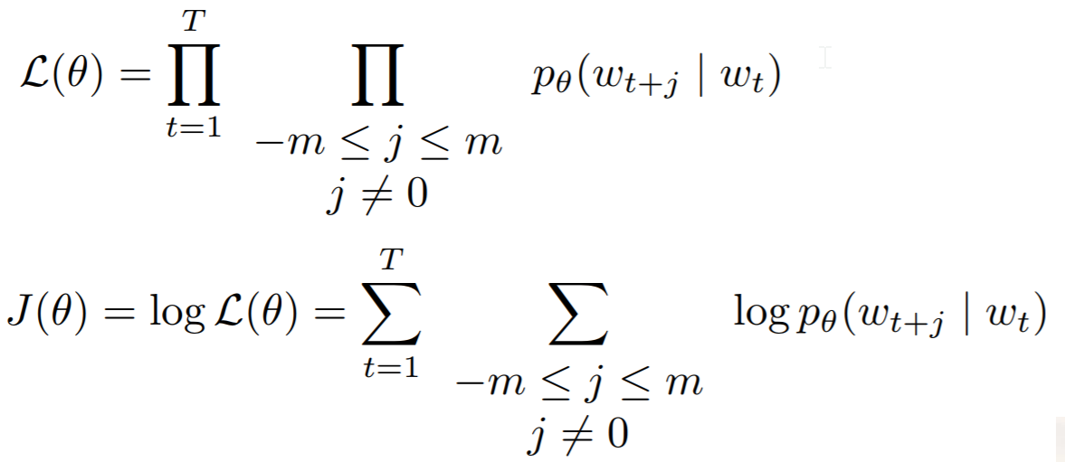

Define objective function for corpus of length T:
Effect
m is chosen to 5~10
Similar words have similar vectors
Because similar words more likely appear close to each other
$$\log{\frac{exp⁡(u_{w_{t+j}}′v_{w_{t}})}{\sum_{p=1}^{|V|}{exp⁡(u_{w_{p}}′v_{w_{t}})}}}$$
All the words in the vocab

Slide 15
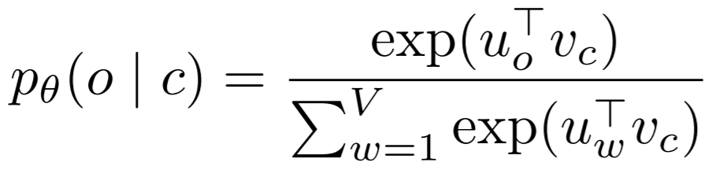
Negative Sampling
The normalization term is computationally expensive
Each probability involves |V| terms for normalization
Negative sampling
Only sample a small number of words that do not appear in the context
Essentially, put more weights on positive samples

Slide 16
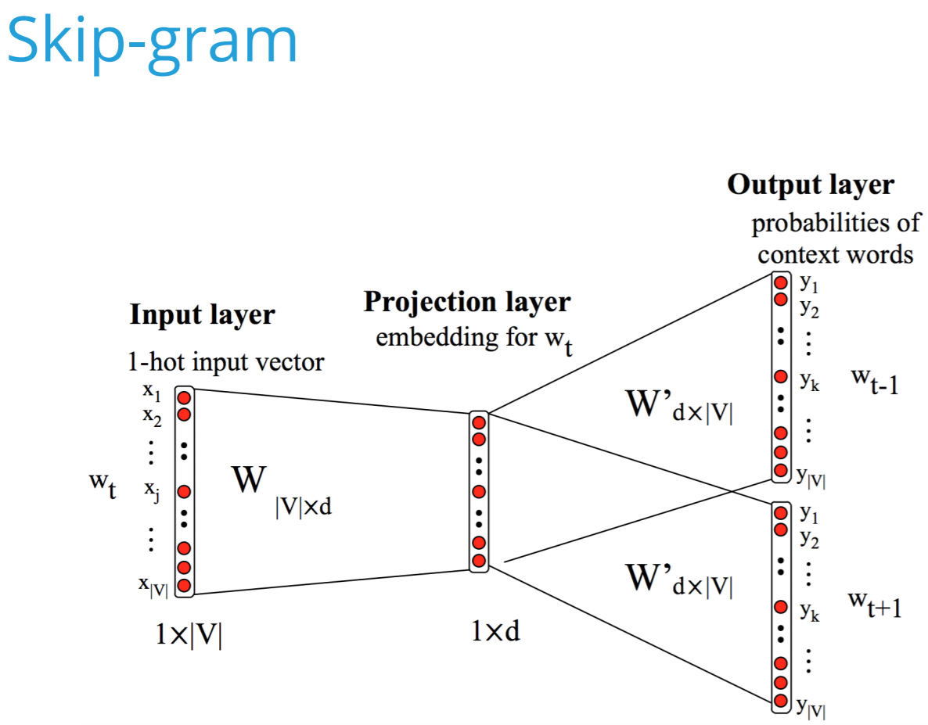

Slide 17
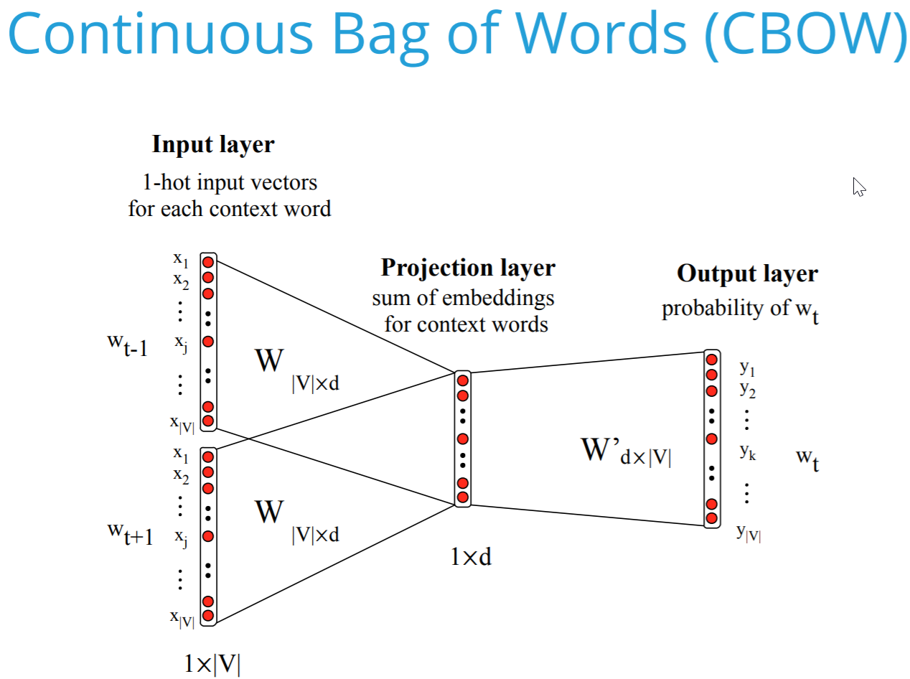

Slide 18
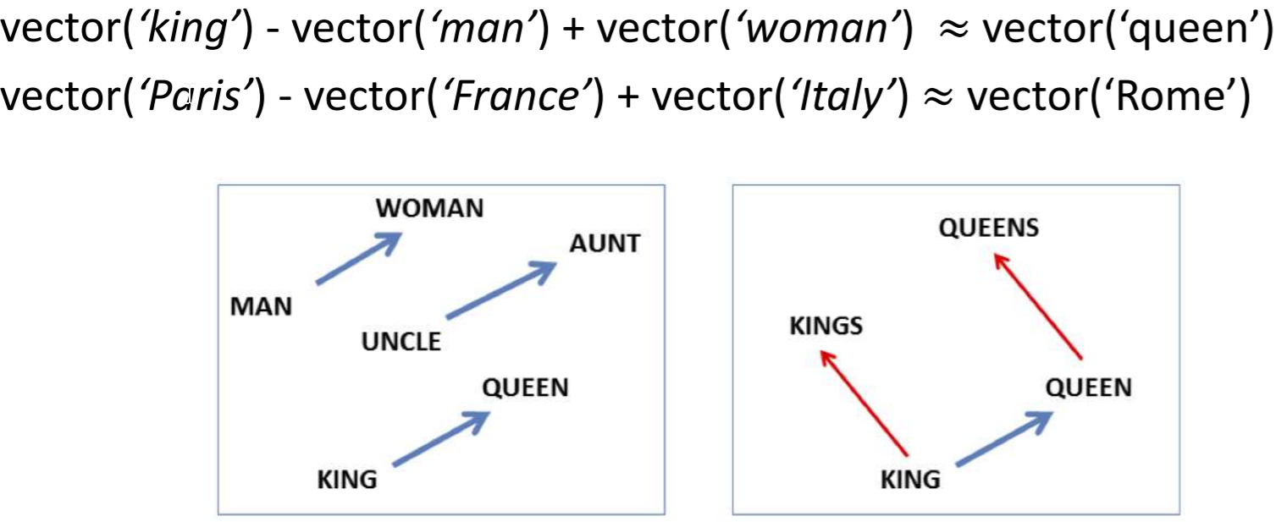
Continuous Semantic Representation
Embeddings capture relational meaning!

Slide 19
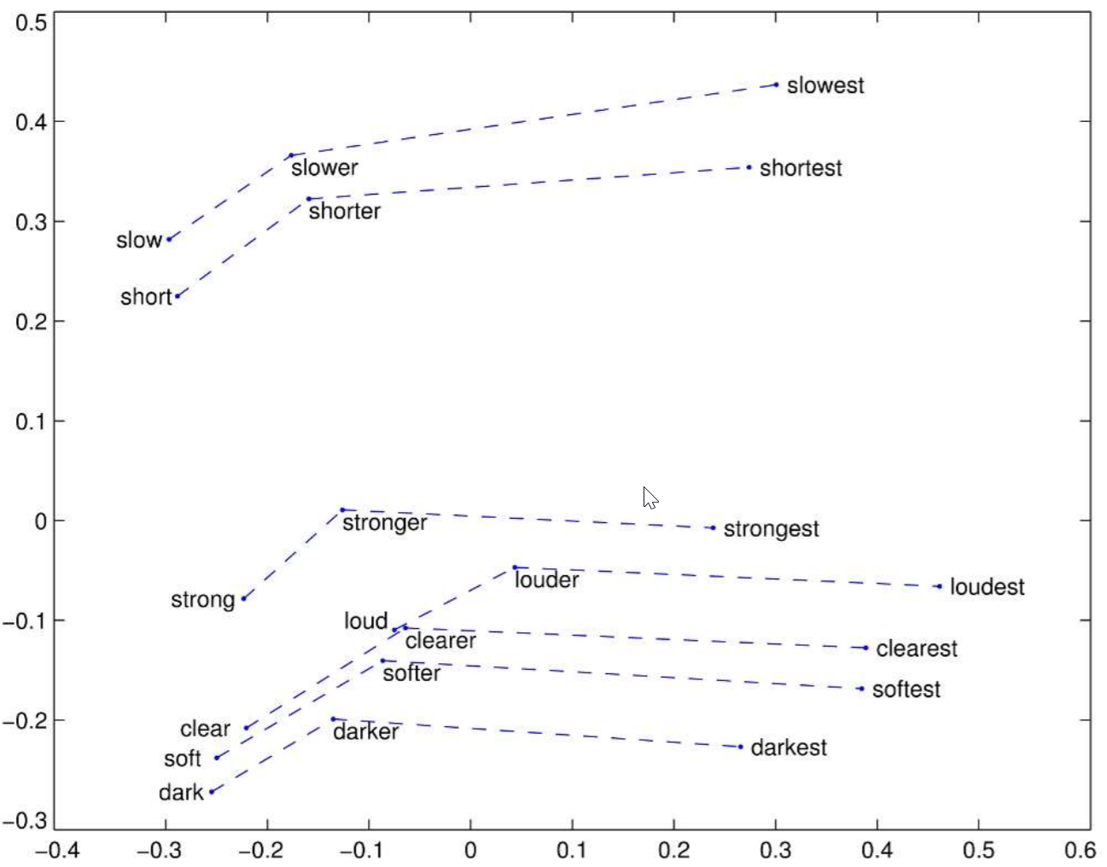

Slide 20
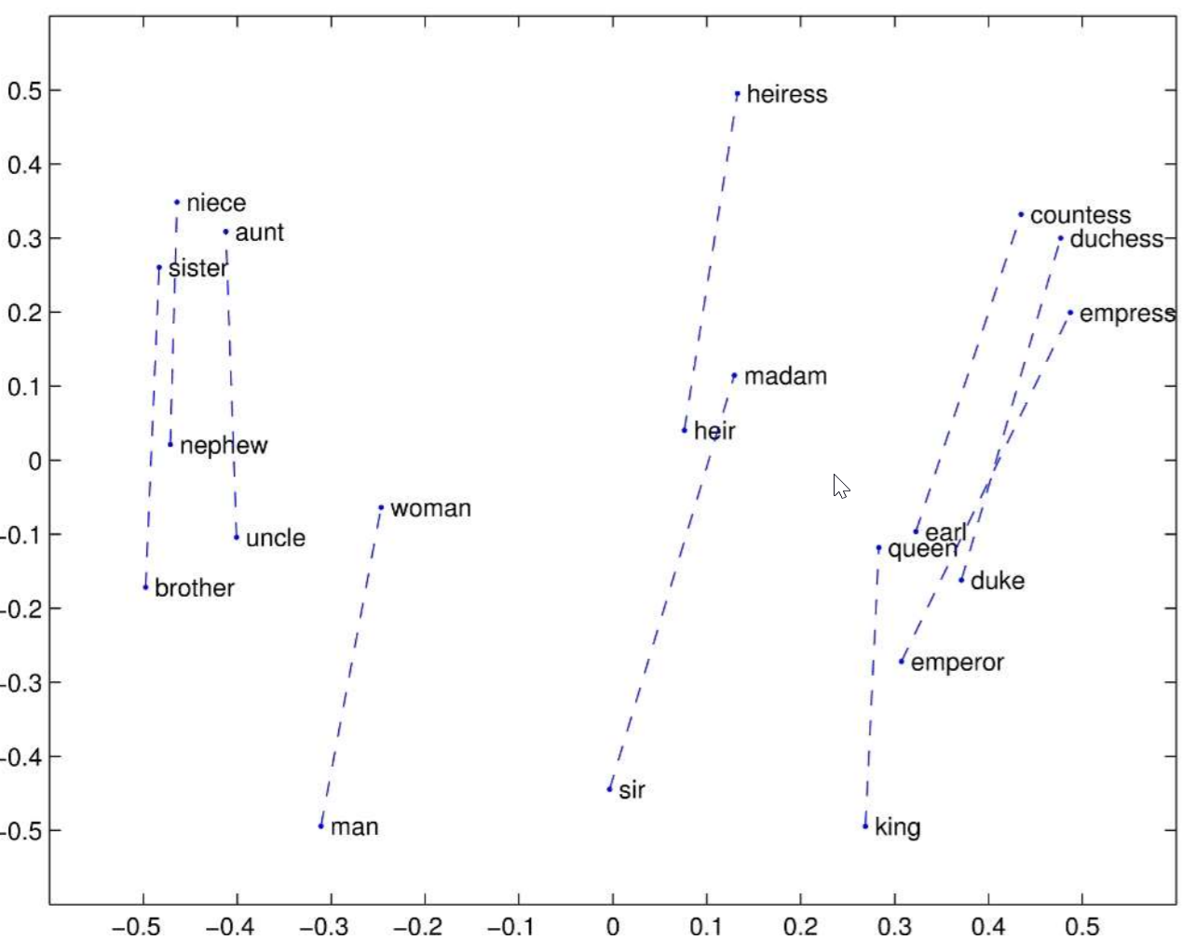

Slide 21
Application of word embedding
Word embeddings are successfully used for various NLP applications (usually simply for initialization)
◦ Semantic similarity
◦ Word sense Disambiguation
◦ Semantic Role Labeling
◦ Named entity Recognition
◦ Summarization
◦ Question Answering
◦ Textual Entailment
◦ Coreference Resolution
◦ Sentiment analysis
◦ etc.

Slide 22
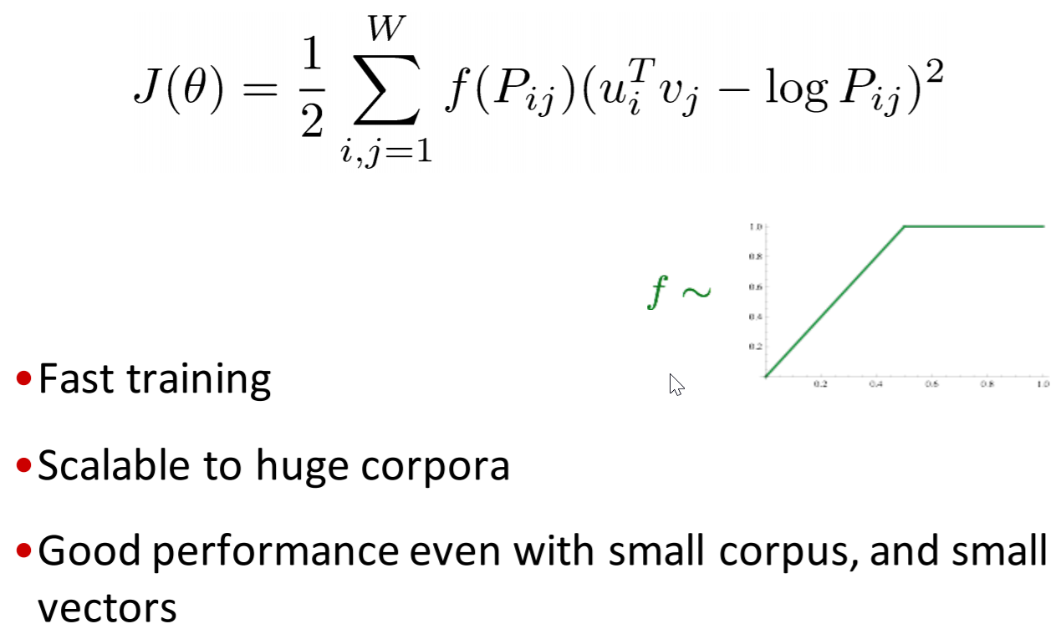
Combining Two Directions
Matrix Factorization based methods for embedding
SVD, Laplacian Eigenmap (counting based)
Make predictions within local context windows
Word2vec (prediction based)
GLOVE Algorithm: Combine the best of both
https://nlp.stanford.edu/pubs/glove.pdf
P_ij: Number of times word i appears with context word j

Slide 23
Limitations of Word2vec
Ambiguity-What if there are two Amsterdams?
One vector per word (even if the word has multiple senses)
Cosine similarity not sufficient to distinguish antonyms from synonyms
Embeddings reflect cultural bias implicit in training text

Slide 24
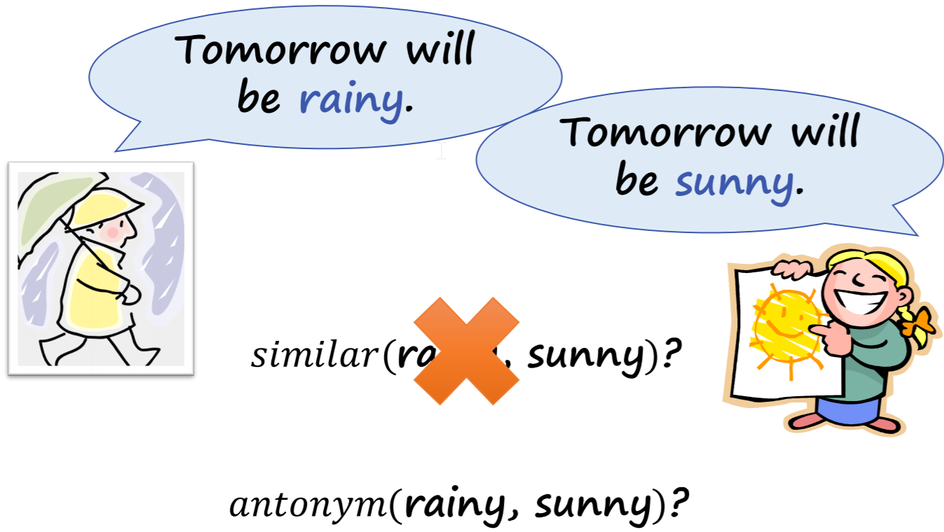
Semantic needs more than similarity

Slide 25
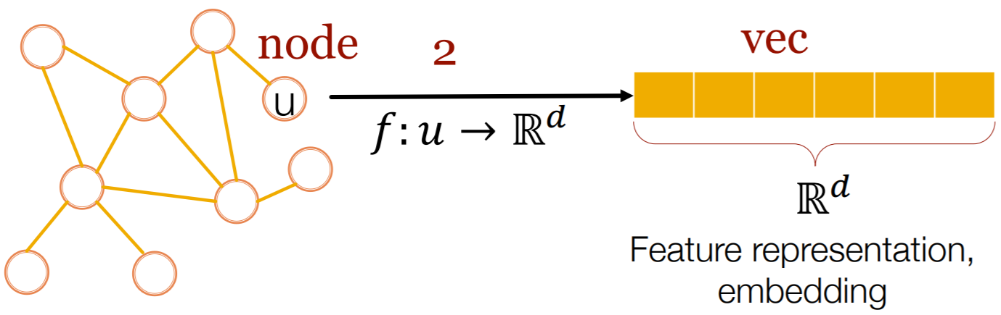
Node2vectors
Efficient task-independent feature learning for machine learning in networks!
Very similar to word2vec setting
Slight modifications needed

Slide 26
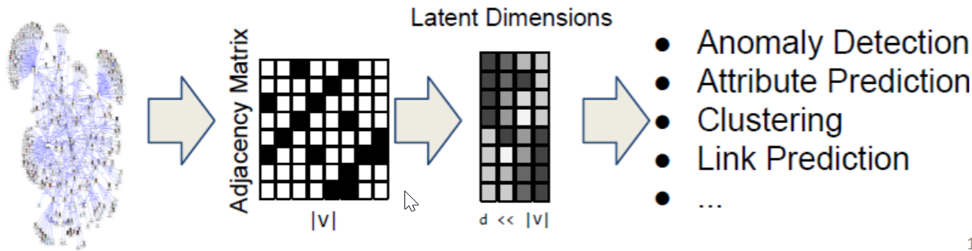
Why node embedding
We map each node in a network into a lowdimensional space
Distributed representation for nodes
Similarity between nodes indicates link strength
Encode network information and generate node representation

Slide 27
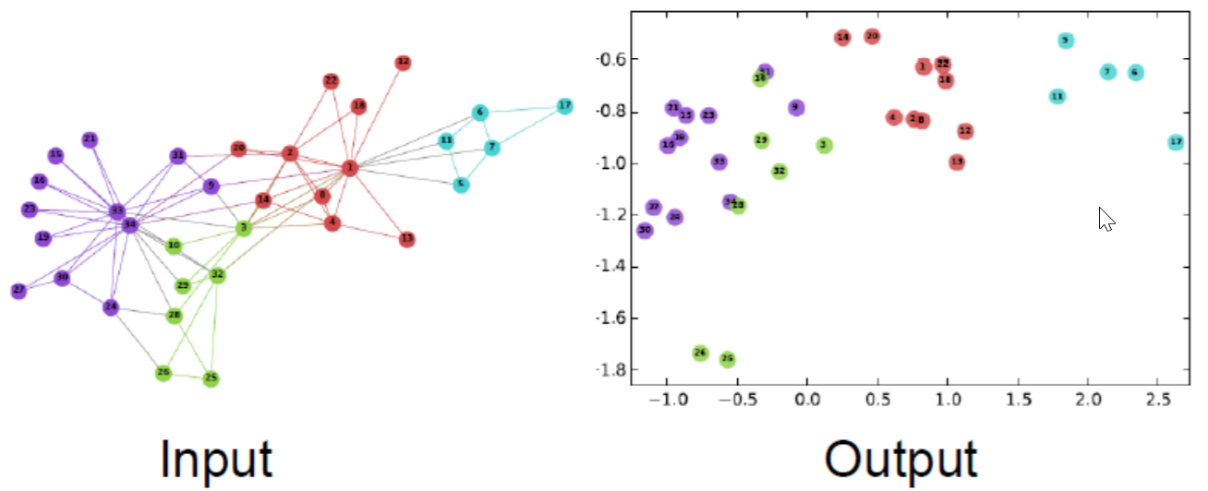
Zachary’s Karate Club network:

Slide 28
Difficulties of Graph Embedding
Node Embedding is hard
Images are fixed size (convolutions)
Texts are linear (word2vec)
Graphs are neither of these
Node numbering is arbitrary (node isomorphism problem)
Much more complicated structure than a chain

Slide 29
Node2vec
Reference: node2vec: Scalable Feature Learning for Networks
A. Grover, J. Leskovec. KDD 2016.
Goal: Embed nodes with similar neighborhoods close in the feature space.
Find embedding of nodes to d-dimensions that preserves similarity
Method: Using random walks to generate node sequence
Which is similar to a text sequence
Different schemes to choose ``neighbors’’

Slide 30
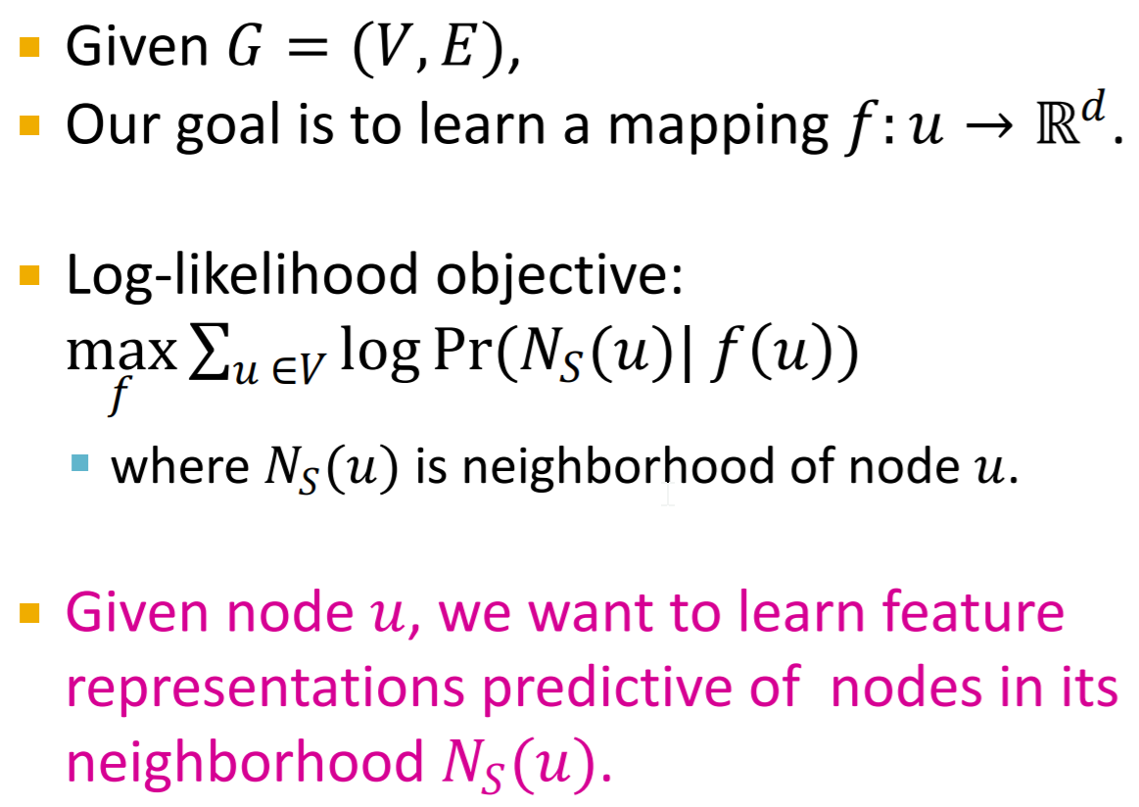

Slide 31
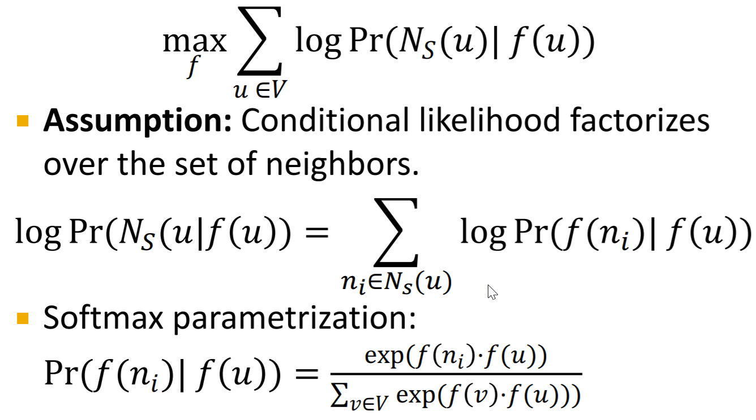

Slide 32
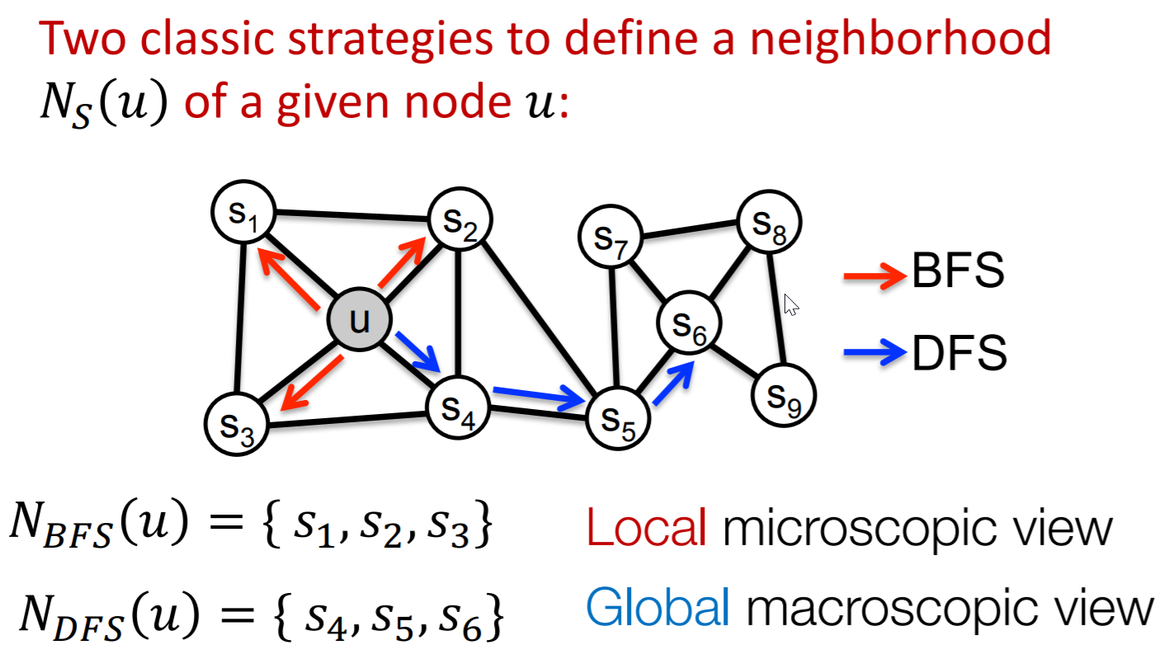
Find Neighbors

Slide 33
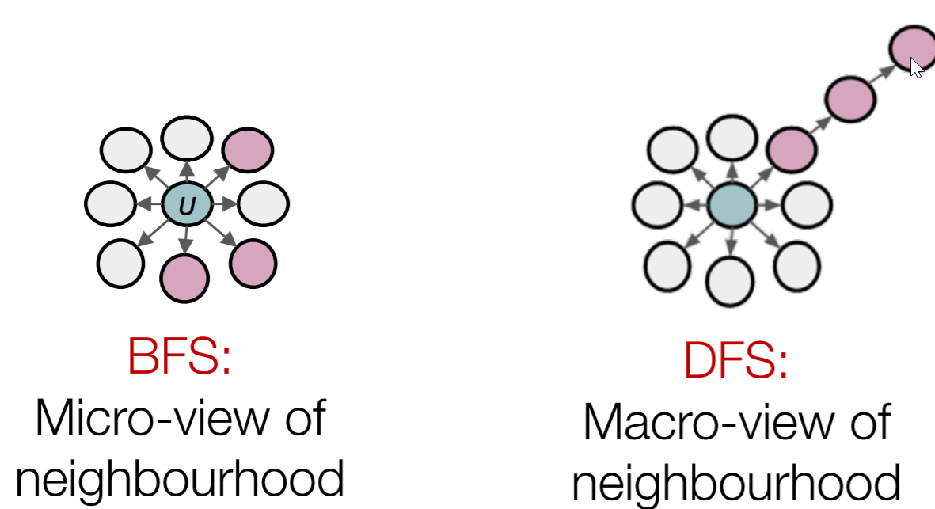
BFS vs DFS

